Slide 1
Deep Learning Classifier Lab
Adviser：范志鵬 教授
Speaker：陳華倫

Slide 2
Outline
Keras & Tensorflow version
CUDA Cudnn version
Label
Training
Testing

Slide 3
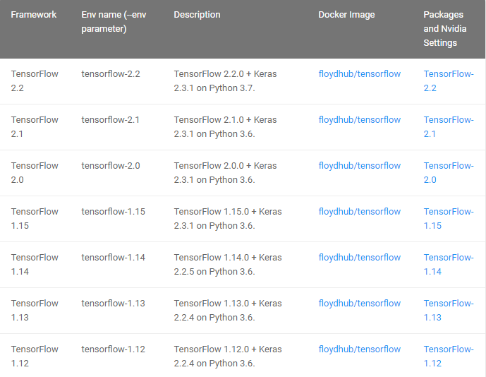
Keras & Tensorflow version
https://docs.floydhub.com/guides/environments/

Slide 4
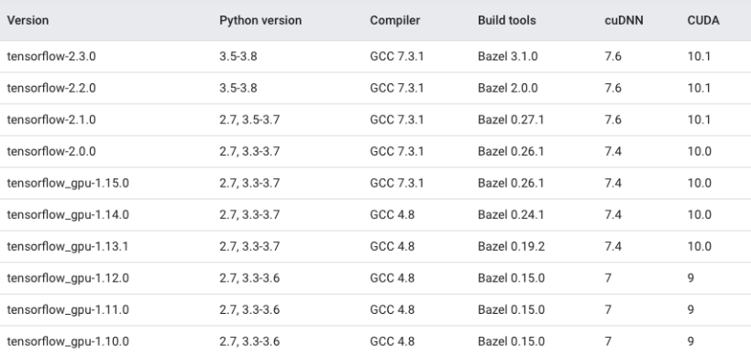
CUDA & Cudnn version
https://stackoverflow.com/questions/50622525/which-tensorflow-and-cuda-version-combinations-are-compatible

Slide 5

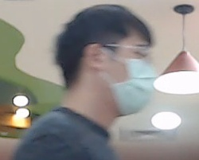




Label
To train the model with supervised learning, you need to label the data first
F
R
B
L
F
L

Slide 6
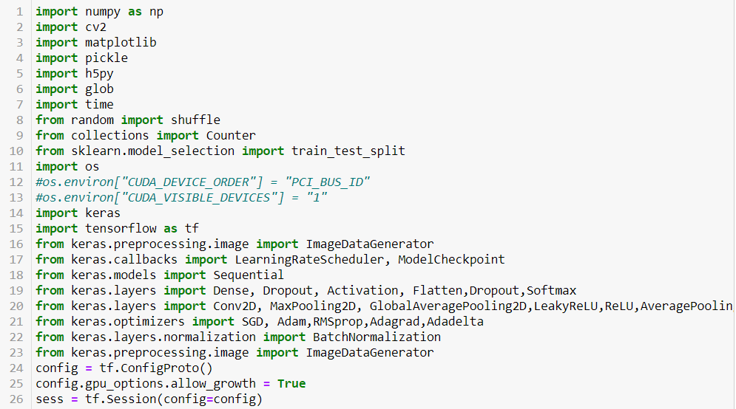
Training
Import module

Slide 7
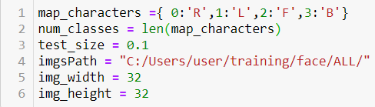
Training
Define the classes and Image path, Width, Height

Slide 8
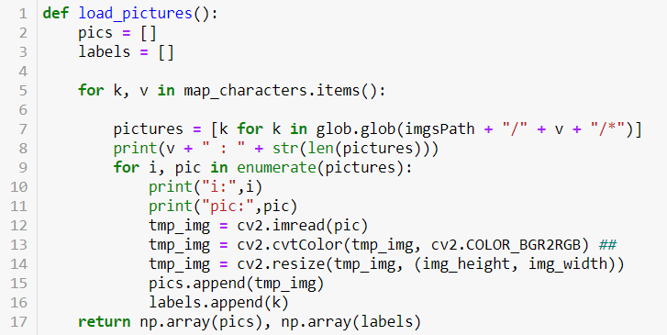
Training
Define a function to do Picture preprocessing

Slide 9
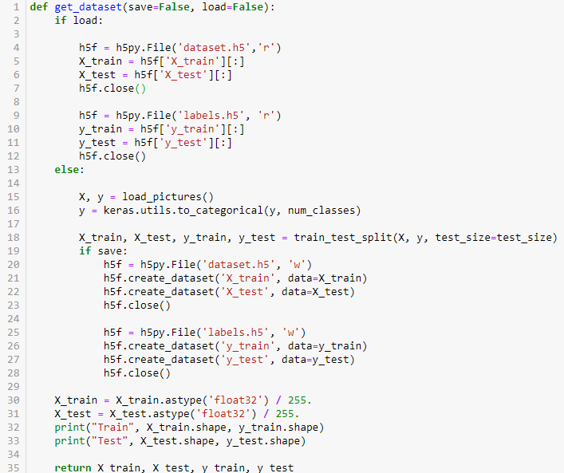
Training
Define a function to do Data normalization, and split the dataset into 9:1

Slide 10
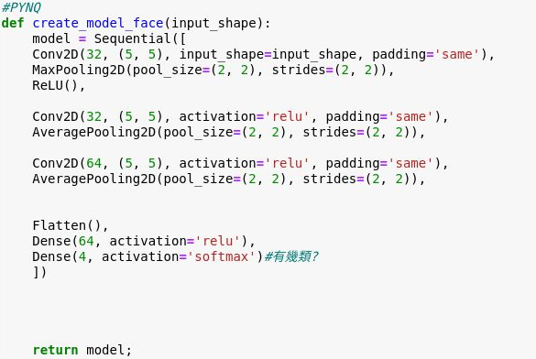
Training
Define a CNN architecture

Slide 11
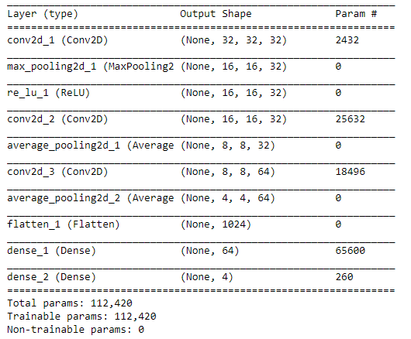
Training
Create the model

Slide 12

Training
Define your optimizer and loss function
Split the dataset into 8:1:1

Slide 13
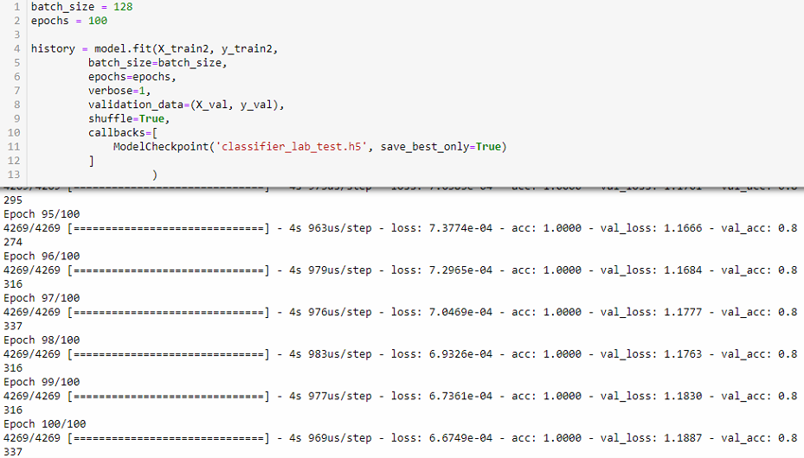
Training
Define your batch size and epochs, then start training

Slide 14
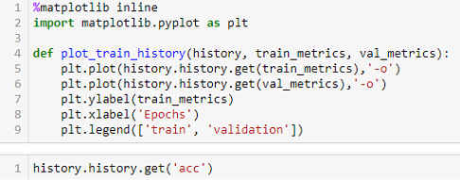
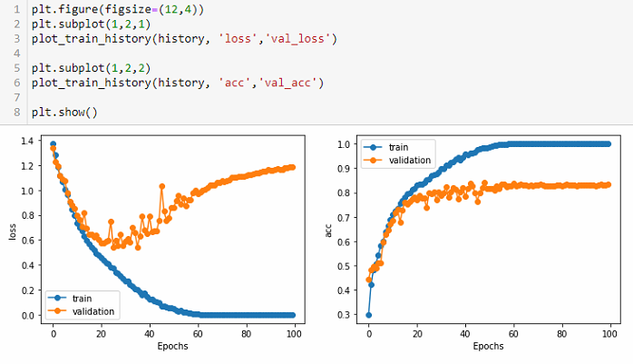
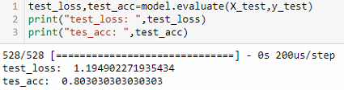
Training
Plot training, validation loss and accuracy

Slide 15
Lab1 Practice
Lab1-1 Practice:
Put more labeled data into the dataset, then train your cifar10 model or other model
Analyze the Recall、Precision、Accuracy、F1-score of Training data、Validation data、Test data for each classes (just divide 4 to get Overall)
Training data analysis
Classes | Recall | Precision | Accuracy | F1-Score
R
L
F
B
Overall
Example

Slide 16
Lab1 Practice
Lab1-1 Practice:
Put more labeled data into the dataset, then train your cifar10 model or other model
Analyze the Recall、Precision、Accuracy、F1-score of Training data、Validation data、Test data for each classes (just divide 4 to get Overall)
Validation data analysis
Classes | Recall | Precision | Accuracy | F1-Score
R
L
F
B
Overall
Example

Slide 17
Lab1 Practice
Lab1-1 Practice:
Put more labeled data into the dataset, then train your cifar10 model or other model
Analyze the Recall、Precision、Accuracy、F1-score of Training data、Validation data、Test data for each classes (just divide 4 to get Overall)
Test data analysis
Classes | Recall | Precision | Accuracy | F1-Score
R
L
F
B
Overall
Example

Slide 18
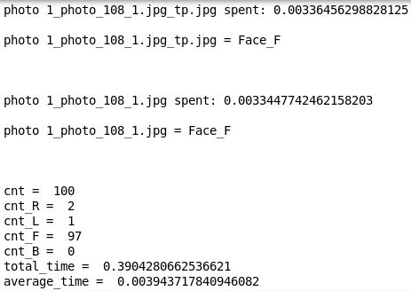
Lab1 Practice
Lab1-2 Practice:
Load the model you trained in another python code, and use it to predict your photos
Result

Slide 19
Thanks for your listening!

